Slide 1
Comp 2000, Data Structures
Bag Application Grocery Bagger
Group 17
Matt Lefebvre – GroceryItem/GroceryBag
Brian Howard – Sorting the GroceryItems
Rodney Chan – Parsing the GroceryItems

Slide 2
Application
Created GroceryItem class to model grocery items
Created GroceryBag class to store grocery items. GroceryBags have a set capacity (based on GroceryItemSize.sizeValue of the items) and add calls that exceed the capacity will be rejected
Created method to parse GroceryItems from a specified path
Created method to sort a List<GroceryItem> into Bags that separate breakable, heavy, and misc items

Slide 3
Issues and Solutions
Designing the GroceryItem and GroceryBag classes were challenging because some of the attributes are unnecessary for sorting the items. As well as finalizing a design for the GroceryBag class
We had trouble prioritizing what characteristics would determine how the items were sorted. We settled on having three categories: breakable items, heavy items, and other items that fit into neither of these categories

Slide 4
Take-aways
Enhanced our understanding of the Bag ADT and situations where it is useful
Enhanced our understand of concepts from Unit 1
Practiced good Objected-Oriented Programming: Abstraction and Encapsulation
That sorting groceries is more complicated than it seems

Slide 5
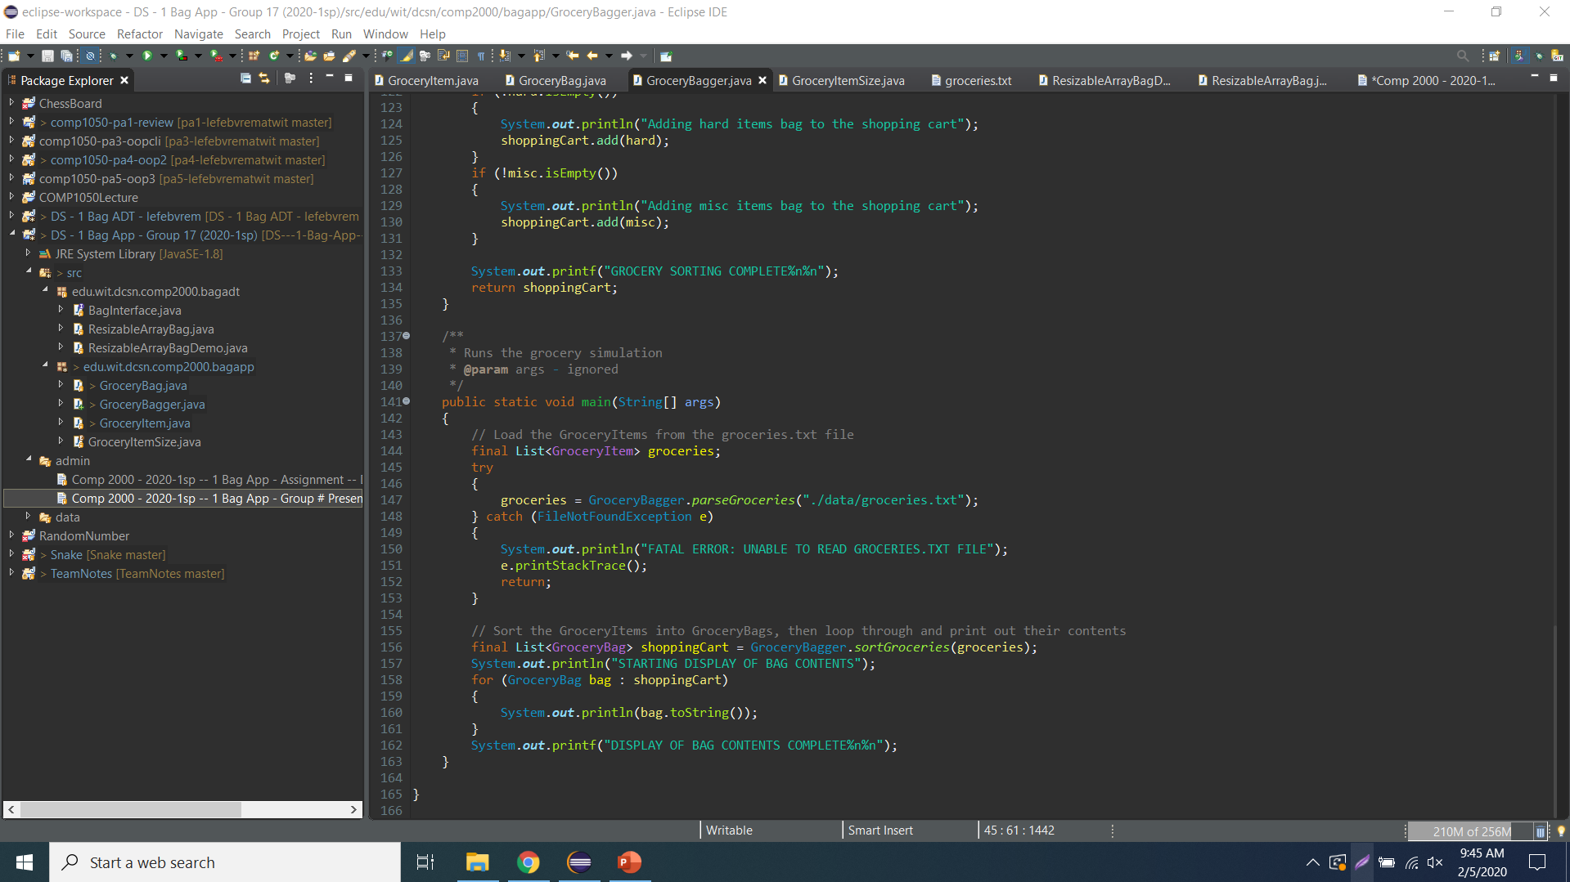
Demo

